Slide 1


End-to-End Translation of Contemporary Egyptian Arabic Dialect
Project ID: AI_Microsoft1_May2022
Team ID: AI-5
Presented by:
Eman Ahmed Abdelaziz Mohamed, 300327227
Yomna Mohamed Sayed, 300327306
Sondos Mohammed Hussein Ali, 300327219
Ahmed Abdo Amin Abdo,300327306
Alaa Tohamy Mohamed Abdelwahab, 300327217

Slide 2

Problem Definition:- According to the literature review of the machine translation domain, there is no speech translation model based on the end to end architecture for the Egyptian dialect language.
Potential Benefits to Sponsor/Users:
People can communicate easily without studying the entire language .
companies can offer training and other eLearning in a multilingual format.
Project Mentor:
○Dr. Soha Makady
Project Sponsor:
○Dr. Ahmed Tawfik
Project uOttawa support:
○Dr. Wail Mardidni

Slide 3
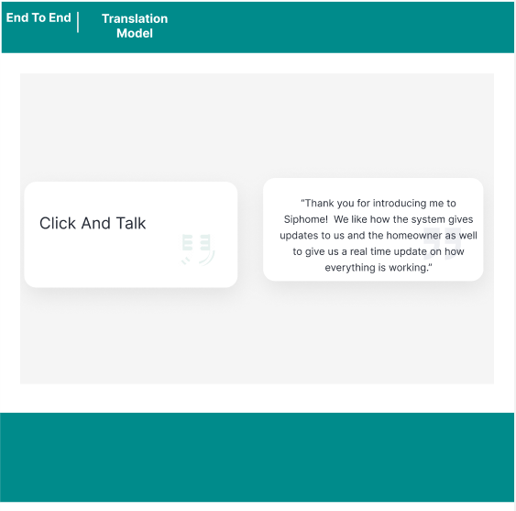
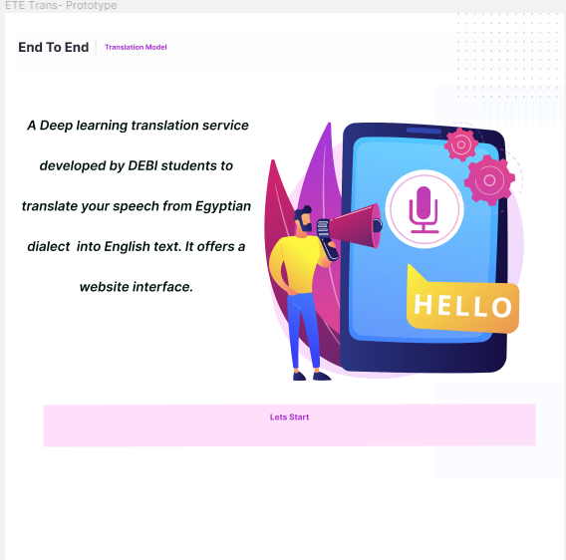
Prototype using Figma
Clickable Prototype : https://www.figma.com/proto/eKMolYJxOugIyeGhhOpK0A/siphome-landing-page-agensip?page-id=0%3A1&node-id=0%3A2&viewport=-114%2C-1174%2C0.54&scaling=min-zoom&starting-point-node-id=0%3A2

Slide 4
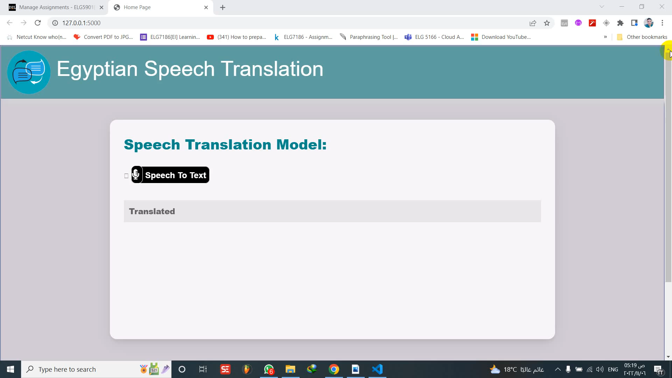
Project DEMO

Slide 5
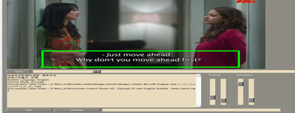
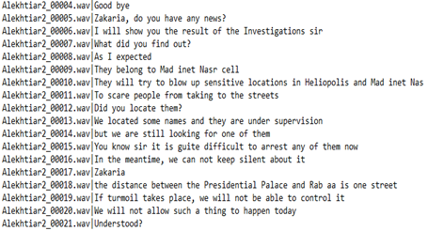
Critical Requirements 1 :-
Yomna Mohamed:300327306
• low resource language .
• Collecting data manually
Solution Design:-
• We collected about 400 hours in Egyptian dialect from English movies dubbed, Arabic films, series and YouTube videos with their transcript srt file in English.
• ALso Extracting subtitles from films by using
Video-subtitle-extractor (vse) a free, open-source tool.
Prepare about 240,000 record of audio data.
• Making the metadata file(with our python script), each record in
themetadata consists of the audio name and its translation.

Slide 6
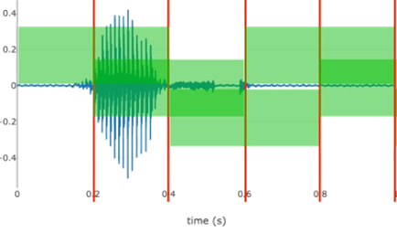
Critical Requirements 2 :-
Sondos Mohamed:300327219
• prepare a data in a suitable format .
• feature extraction
Solution Design:-
• Using librosa to remove the start and end of the audio.
•Make the length of each cutting audio is maximum 6 second.
•Converting the text to numbers and to make its length suitable to enter the model.
•Doing normalization to the features.
•Applying feature extraction technique as MFCC (Mel Frequency Cepstral Coefﬁcient) by using pytorch.

Slide 7
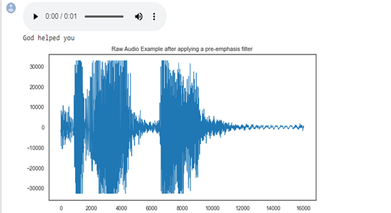

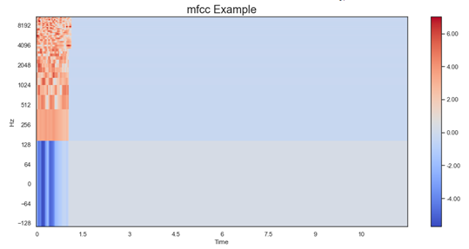
Solution Design Con.
Ahmed Abdo : 300327306
•This is a raw audio example after applying a pre-emphasis filter to :
balance the frequency spectrum since high frequencies usually have smaller magnitudes compared to lower frequencies.
avoid numerical problems during the Fourier transform operation.
may also improve the Signal-to-Noise Ratio (SNR).
Visualization of the data after applying feature extraction

Slide 8
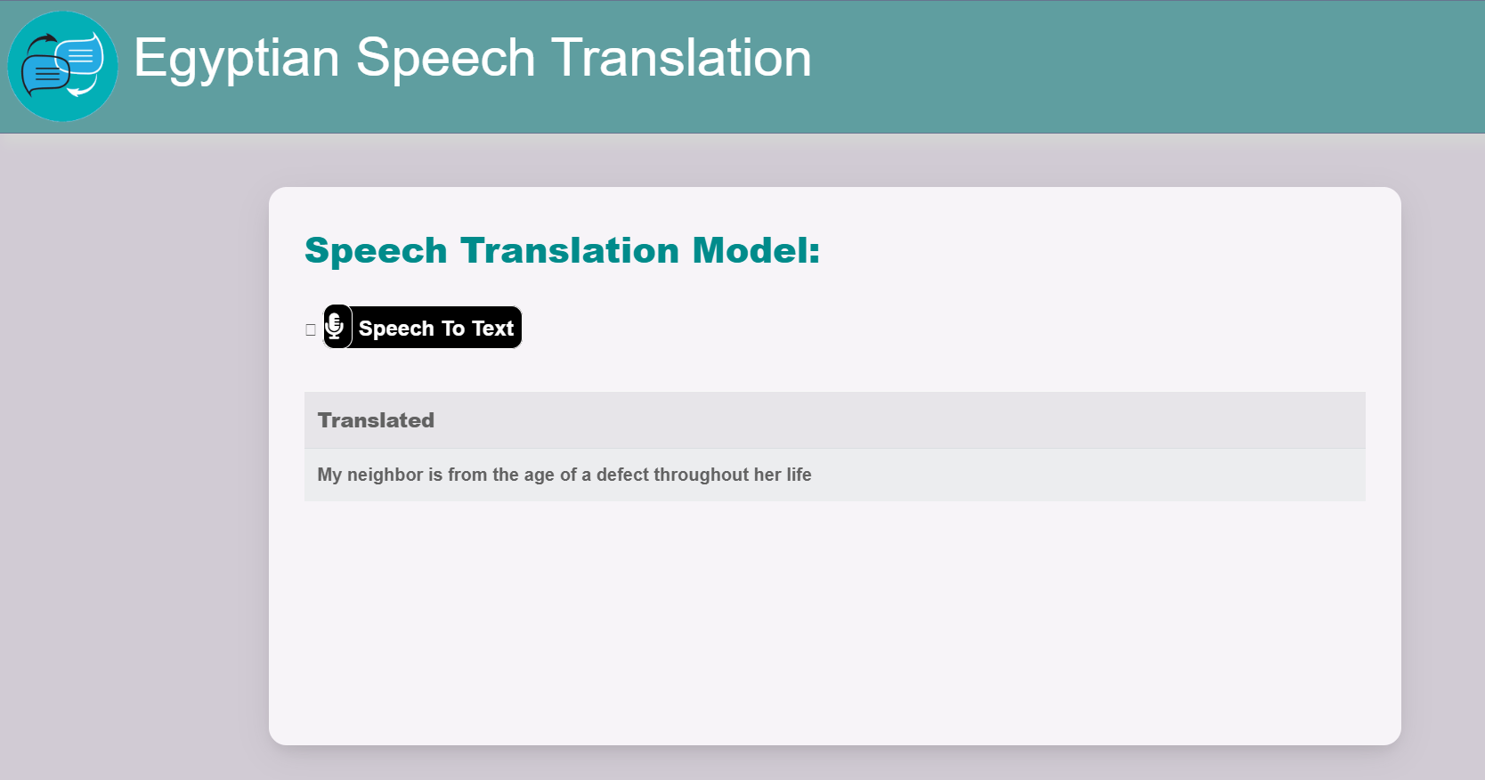
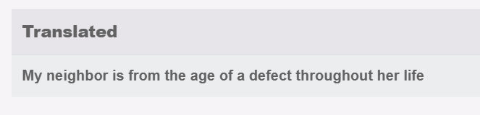
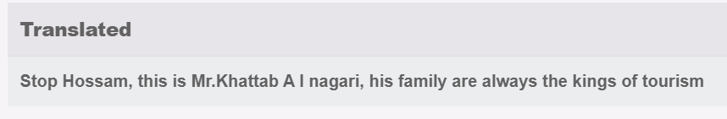
Critical Requirements 3 :-
Ahmed Abdo :300327306
Designing a web interface.
Connecting user interface with our model.
Solution Design:-
•Using HTML , CSS and Javascript for the design.
•Using a flask library to connect our model with the user interface.
Evalution:
Incorrect
Correct
The model has not trained enough, so it needs training by large dataset.

Slide 9
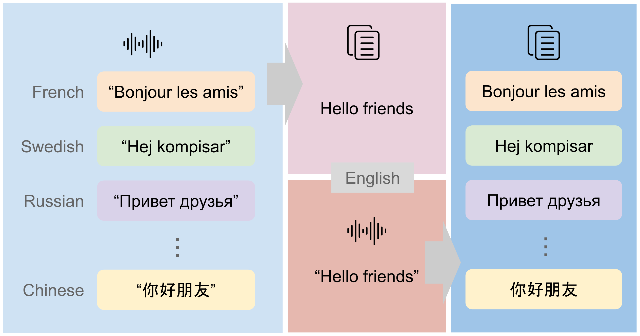
Critical Requirements 4 :-
Alaa Basuny : 300327217
End to End model architecture.
Pre trained model on Arabic language.
Solution Design:-
CoVoST: A Large-Scale Multilingual Speech-To-Text Translation Corpus based on Common Voice,
translations from 21 languages into English with Arabic word error rate 0.3
To achieve scale and sustainability, we will use common voice technique to our data set with CoVoST corpus.
By utilize Fairseq(-py) modeling toolkit to train custom models for translation.

Slide 10

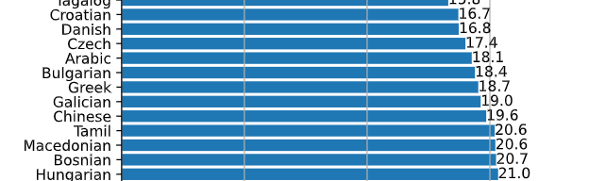
Critical Requirements 4 Cont. :-
Eman Mohamed: 300327227
End to End model architecture.
Pre trained model on Arabic language.
Solution Design:-
Whisper is an automatic speech recognition (ASR) system trained on 680,000 hours of multilingual and multitask supervised data collected from the web.
The Whisper architecture is end-to-end approach,
It used Python 3.9.9 and PyTorch 1.10.1 to train and test models
Whisper word error rate (WER) is 17.4 in Arabic language.
Our status is fine-tuning whisper model.

Slide 11
References:-
[1] Audio Pre-Processing For Deep Learning
Link: https://www.researchgate.net/publication/347356900_Audio_Pre-Processing_For_Deep_Learning
[2]Denoising Speech for MFCC Feature Extraction Using Wavelet Transformation in Speech Recognition System DOI: 10.1109/ICITEED.2018.8534807
[3] Improving CTC Using Stimulated Learning for Sequence Modeling DOI: 10.1109/ICASSP.2019.8682700
[4]Sequence ModelingWith CTC Link: https://distill.pub/2017/ctc/
[5] Neural Machine Translation from Jordanian Dialect to Modern Standard Arabic DOI: 10.1109/ICICS49469.2020.239505
[6] CRAN: A Hybrid CNN-RNN Attention-Based Model for Arabic Machine Translation link: https://rdcu.be/cUtyt

Slide 12
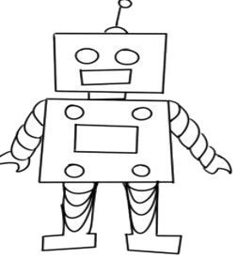
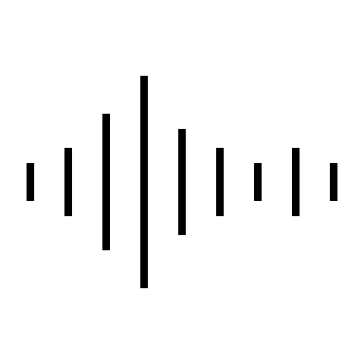

Thank You, Any Questions ?

